Slide 1
Parte 5

Slide 2
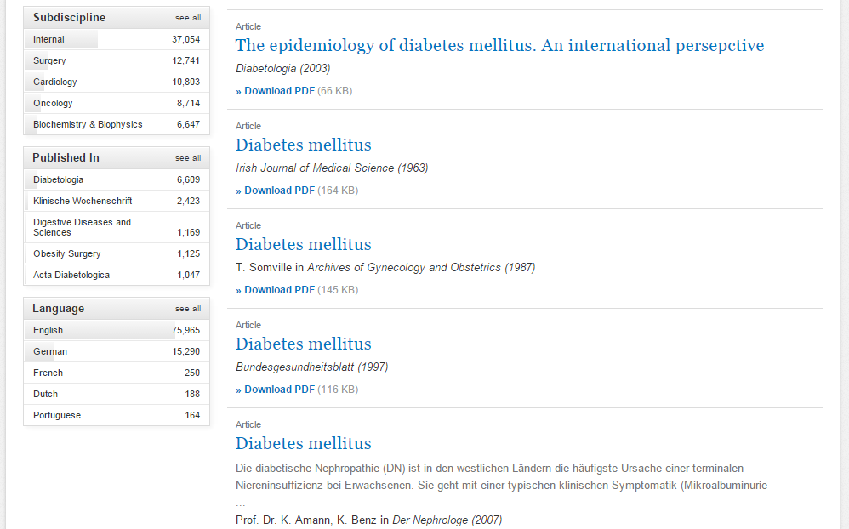
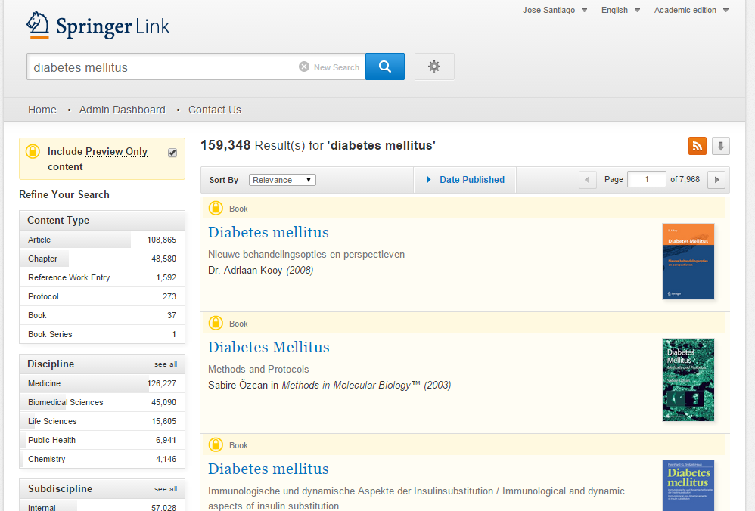
Búsquedas y recuperación de contenido
Búsqueda Simple: diabetes mellitus +filtrar sólo a resultados con acceso +utilizar el módulo Published in para encontrar el journal que más publica en el tema
Notes:
CHRM2 but not CHRM1 or CHRM3 polymorphisms are associated with asthma susceptibility in Mexican patients.
Jiménez-Morales S, Jiménez-Ruíz JL, Del Río-Navarro BE, Navarro-Olivos E, Escamilla-Guerrero G, Savan R, Dean M, Orozco L.
Author information
Abstract
Asthma is a complex disease for which genetic predisposition has been widely documented. Considerable evidence supports the hypothesis that polymorphisms in the muscarinic-cholinergic (CHRM) genes could be involved in asthma pathogenesis, bronchial hyperresponsiveness, and mucus secretion. To determine whether single nucleotide polymorphisms (SNPs) or haplotypes in CHRM1, CHRM2, or CHRM3 are associated with asthma in Mexican pediatric population.

