Slide 1
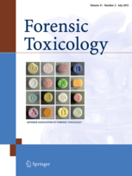
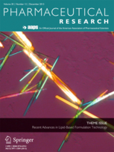
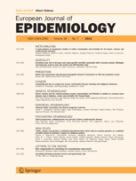
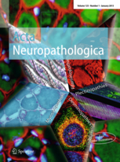
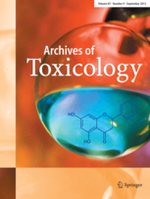







Títulos de alto factor de impacto en 12 especialidades médicas (3)
Journals
#
Pathology:
pathology, forensic medicine and science.
#
Pharmacology & Toxicology:
pharmaceutical sciences/technology, medicinal chemistry,
biotechnology, human genetics, immunology
#
Public Health:
health promotion & disease prevention,
maternal & child health and psychology
epidemiology, health administration, biostatistics
IF: 3.194
IF: 4.742
IF: 5.118
IF: 5.215
IF: 9.734
IF:3.570

Slide 2
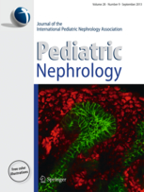
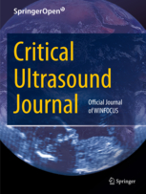
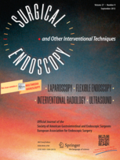
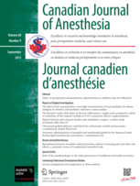
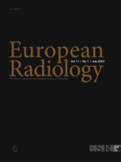
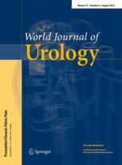






Títulos de alto factor de impacto en 12 especialidades médicas (4)
Journals
#
Surgery & Anesthesiology:
anesthesiology, general, colorectal, thoracic,
cardiovascular, maxillofacial, robotic, plastic, pediatric
and abdominal surgery, proctology .
#
Radiology:
diagnostic, interventional and neuroradiology,
radiotherapy and ultrasound
#
Urology and Gynecology :
Urology & Andrology, Nephrology,
Gynecology
IF:2.939
IF: 3.102
IF: 3.427
IF: 2.127
IF:3.548
IF:2.888

