Slide 1
Parte 2

Slide 2
Evaluating significance
Los avances conceptuales incrementarán la importancia de su manuscrito
Novelty
How new are your findings?
Si sus resultados pueden aplicarse a una población más amplia, la importancia de su manuscrito será mayor
Relevance
How broadly relevant are your findings?
Appeal
What are the important real-world applications?
Si sus resultados aplican a la población en general también se incrementará la importancia de su manuscrito

Slide 3
How many journals are there?
How many journals are indexed by ISI (have impact factors)?
Science Citation Index
8613
¿Cómo se elige la publicación adecuada para enviar su manuscrito?
Social Science Citation Index
3114
Arts and Humanities Citation Index
1440
13,167*
*October 2013
http://ip-science.thomsonreuters.com/mjl/

Slide 4
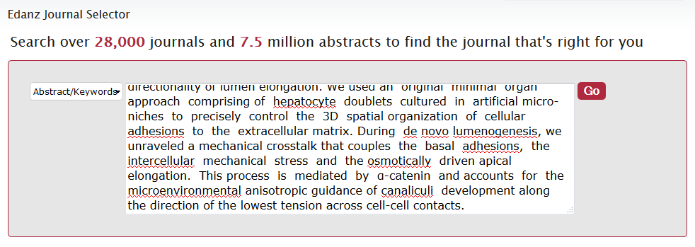
Journal Selector www.edanzediting.com/journal_selector
Selector de publicaciones de Edanz
Insert your proposed abstract
or keywords

Slide 5
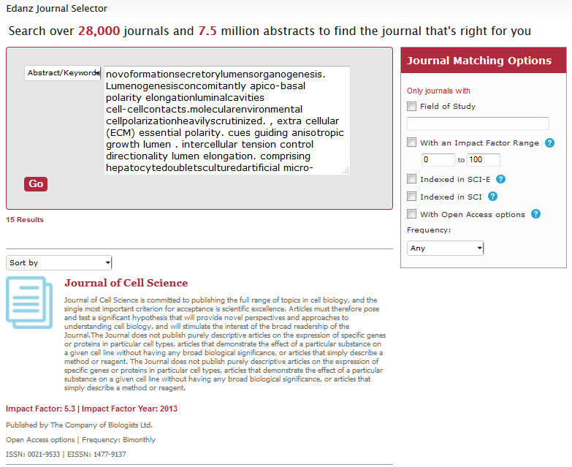
Journal Selector www.edanzediting.com/journal_selector
Journal’s aims & scope, IF,
and publication frequency
Filter by:
Field of study
Impact factor
Indexed in SCI
Open access
Publishing frequency

Slide 6
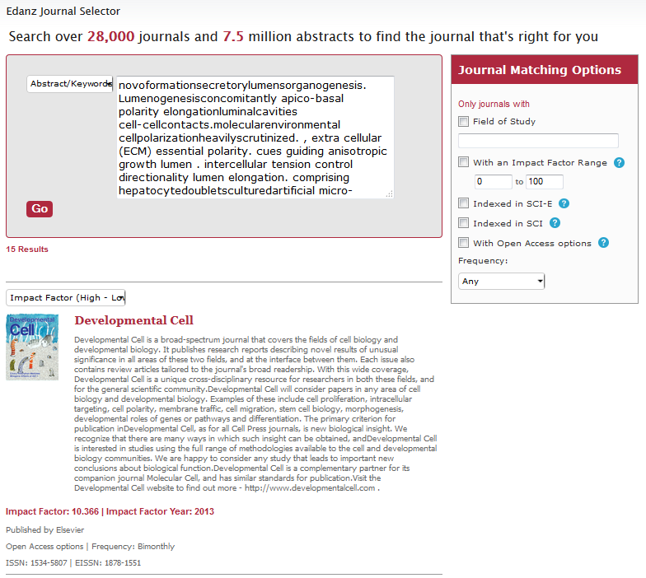
Journal Selector www.edanzediting.com/journal_selector
Sort by:
Relevance
Impact Factor
Frequency

Slide 7
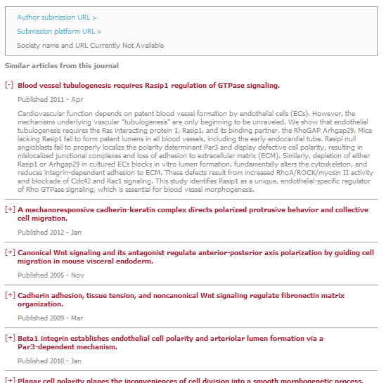
Journal Selector www.edanzediting.com/journal_selector
Author guidelines
Journal website
Similar published articles
Are they currently publishing similar articles?
Have you cited any of these articles?

Slide 8
Tips to identify the most suitable journal
S
Identify the interests of the journal editor
Editorials
Review articles
Special issues
¿Cómo se elige la publicación adecuada para enviar su manuscrito?
Notes:
Learn by example
Learn the difference between good and bad writing

Slide 9
Tips to identify the most suitable journal
S
Journal editor’s interests
Journal A
Journal B
Journal C
Editorials
Review articles
Special issues
Editorials
Review articles
Special issues
Editorials
Review articles
Special issues
Manuscript
Notes:
Learn by example
Learn the difference between good and bad writing

Slide 10
Tips to identify the most suitable journal
S
Identify the interests of the journal editor
Editorials
Review articles
Special issues
Identify the interests of the readers
Most viewed
Most cited
Notes:
Learn by example
Learn the difference between good and bad writing

Slide 11
Tips to identify the most suitable journal
S
Reader’s interests
Journal A
Journal B
Journal C
Most viewed
Most cited
Most viewed
Most cited
Most viewed
Most cited
Manuscript
Notes:
Learn by example
Learn the difference between good and bad writing

Slide 12
Who’s hungry?
Notes:
First impression of the relevance of your aims, importance of your results, validity of your conclusion, and writing style
Need to summarize these points. Emphasize how your conclusion it relevant in the context of the background
You are trying to convince your audience to read your paper, so focus on your results and conclusions

Slide 13
Section 3
Download at: http://www.edanzediting.com/sa2015
Manuscript structure

Slide 14
Use your figures to structure your manuscript
No escriba su manuscrito en el mismo orden en que aparece en la versión final
Where to start?
Figure 1
Logical
presentation
Your findings are why you want to publish your work
Form the basis of your manuscript
First step, is to logically organize your findings
Table 1
Figure 2
Is anything missing?
?
Additional analyses?
Figure 3

Slide 15
Use your figures to structure your manuscript
Where to start?
Figure 1
Logical
presentation
Your findings are why you want to publish your work
Form the basis of your manuscript
First step, is to logically organize your findings
Table 1
Figure 2
Figure 3
New data
Figure 4

Slide 16
Prepare an outline
Introduction
General background
Related studies
Problems in the field
Aims
Methods
Subjects/Samples/Materials
General methods
Specific methods
Statistical analyses
Results
Key points about Figure 1
Key points about Table 1
Key points about Figure 2
Key points about Figure 3
Key points about Figure 4
Discussion
Major conclusion
Key findings that support conclusion
Relevance to published studies
Unexpected/negative findings
Limitations
Implications
Future directions
Prepare un esquema puntual de cada sección

Slide 17
Prepare an outline
Introduction
General background
Related studies
Problems in the field
Aims
Methods
Subjects/Samples/Materials
General methods
Specific methods
Statistical analyses
Results
Key points about Figure 1
Key points about Table 1
Key points about Figure 2
Key points about Figure 3
Key points about Figure 4
Discussion
Major conclusion
Key findings that support conclusion
Relevance to published studies
Unexpected/negative findings
Limitations
Implications
Future directions
Introduction
Proporciónele al lector un resumen corto de los antecedentes
What background information
you will introduce

Slide 18
Prepare an outline
Introduction
General background
Related studies
Problems in the field
Aims
Methods
Subjects/Samples/Materials
General methods
Specific methods
Statistical analyses
Results
Key points about Figure 1
Key points about Table 1
Key points about Figure 2
Key points about Figure 3
Key points about Figure 4
Discussion
Major conclusion
Key findings that support conclusion
Relevance to published studies
Unexpected/negative findings
Limitations
Implications
Future directions
Introduction
Indíquele al lector cómo estudió el problema
What background information
you will introduce
Methods
What analyses you will describe

Slide 19
Prepare an outline
Introduction
General background
Related studies
Problems in the field
Aims
Methods
Subjects/Samples/Materials
General methods
Specific methods
Statistical analyses
Results
Key points about Figure 1
Key points about Table 1
Key points about Figure 2
Key points about Figure 3
Key points about Figure 4
Discussion
Major conclusion
Key findings that support conclusion
Relevance to published studies
Unexpected/negative findings
Limitations
Implications
Future directions
Introduction
Indíquele al lector cuáles fueron sus resultados
What background information
you will introduce
Methods
What analyses you will describe
Results
What findings you will present

Slide 20
Prepare an outline
Introduction
General background
Related studies
Problems in the field
Aims
Methods
Subjects/Samples/Materials
General methods
Specific methods
Statistical analyses
Results
Key points about Figure 1
Key points about Table 1
Key points about Figure 2
Key points about Figure 3
Key points about Figure 4
Discussion
Major conclusion
Key findings that support conclusion
Relevance to published studies
Unexpected/negative findings
Limitations
Implications
Future directions
Introduction
Indíquele al lector cuál es el significado de sus resultados
What background information
you will introduce
Methods
What analyses you will describe
Results
What findings you will present
Discussion
What interpretations, limitations, and implications you will discuss

Slide 21
Introduction
General introduction
Current state of the field
Problem in the field
Aims
Specific aims

Slide 22
Introduction – flow of information
Lung cancer is the leading cause of cancer mortality for men and women. Despite smoking prevention and cessation programs and advances in early detection, the 5-year survival rate for lung cancer is only 16% with current therapies. Although lung cancer incidence rates have recently declined in the United States, more lung cancer is now diagnosed when considered together in former- and never-smokers than in current smokers. Thus, even if all of the national anti-smoking campaign goals are met, lung cancer will remain a major public health problem for decades. New ways to treat or prevent lung cancer are therefore needed.
One potential therapeutic target for lung cancer is the Wnt signaling pathway. The canonical Wnt signaling pathway in mammals consists of a family of secreted lipid-modified Wnt protein ligands that bind to a family of 7-pass transmembrane Frizzled (Fzd) receptors, as reviewed. In brief, in the absence of ligand, glycogen synthase kinase-3 (GSK3), in complex with axin and adenomatous polyposis coli (APC), constitutively phosphorylates β-catenin, the primary Wnt signaling effector, targeting it for ubiquitination and proteasomal destruction. Ligand binding engages a pathway involving Dishevelled (Dvl) that inhibits GSK3, allowing β-catenin to accumulate in a hypophosphorylated form. This stabilized form of β-catenin can translocate to the nucleus, where it activates target gene transcription by complexing with T cell factor (TCF) and lymphoid enhancer-binding factor (LEF). In addition to key mediators of embryonic development, these target genes include critical growth-regulators such as myc and cyclin D1.
Aberrant Wnt signaling due to mutations in β-catenin or APC drives deregulated growth in both familial and non-hereditary colorectal cancers. However, non-small cell lung cancers (NSCLC), the most common type of lung cancer, rarely harbor APC or β-catenin mutations. Rather, aberrant Wnt activity in lung cancer is linked to increased expression of upstream Wnt signaling effectors such as Dvl or decreased expression of Wnt antagonists such as Wnt-inhibitory factor 1 (Wif-1).
Effective pharmacological inhibitors of the Wnt pathway have only recently become available. Screens for small-molecule antagonists of the Wnt pathway found two enzymes to be key mediators of Wnt signaling. These are poly-ADP-ribose polymerase (PARP) enzymes, tankyrase (TNKS) 1 and TNKS2, which attach poly-ADP-ribose (PAR) onto substrate proteins. Their roles in regulating telomerase function and mitotic spindle formation are known, but their role in PARsylating axin so as to maintain the optimal level for canonical Wnt signaling has only recently been recognized. The compounds identified in these screens, XAV939, IWR-1 exo, and IWR-1 endo, act by specifically inhibiting the PARP activity of TNKS1 and TNKS2. IWR-exo is a stereoisomer of IWR-1 endo with ~14-fold lower EC₅₀. PARP inhibition is a tractable pharmacological target in vivo, as antagonists of other PARP homologs exert antineoplastic responses in breast and ovarian cancer, as reviewed.
This study explored the hypothesis that inhibition of TNKS by pharmacological or genetic means would inhibit lung cancer growth in vitro and in vivo in clinically-relevant transgenic mouse models of lung cancer that were previously developed, as reviewed.
General introduction
Specific introduction
Objectives
Busch et al. BMC Cancer. 2012; 13: 211.

Slide 23
Writing the Introduction
Beginning should demonstrate
relevance/interest
Interest
Lung cancer is the leading cause of cancer mortality for men and women. Despite smoking prevention and cessation programs and advances in early detection, the 5-year survival rate for lung cancer is only 16% with current therapies. Although lung cancer incidence rates have recently declined in the United States, more lung cancer is now diagnosed when considered together in former- and never-smokers than in current smokers. Thus, even if all of the national anti-smoking campaign goals are met, lung cancer will remain a major public health problem for decades. New ways to treat or prevent lung cancer are therefore needed.
Important problem in the field
Busch et al. BMC Cancer. 2012; 13: 211.

Slide 24
Writing the Introduction
Your aims should directly
address this problem
New ways to treat or prevent lung cancer are therefore needed.
This study explored the hypothesis that inhibition of TNKS by pharmacological or genetic means would inhibit lung cancer growth in vitro and in vivo…
Declare los objetivos específicos de su estudio en el último párrafo
Busch et al. BMC Cancer. 2012; 13: 211.

Slide 25
Methods/Experimental
Experimental Design
What was used
Samples or participants
Materials
How it was done
General methods
Specific techniques
(discuss controls)
How it was analyzed
Qué materiales usó, como realizó el estudio, y cuales fueron los análisis?
Data analysis
Quantification methods
Statistical tests

Slide 26
Results
Key points relating to each display item
Logical presentation
Each subsection corresponds to
one figure
Subsections
What you found, not what it means
Factual description

Slide 27
Display items
Present large amount of data quickly and efficiently
Usually the first thing readers will look at
Figures, graphs & tables
Keep it simple: use separate panels if necessary
Must be able to stand alone: clear labels and figure legends
Las tablas y los gráficos son formas muy efectivas de comunicarse

Slide 28
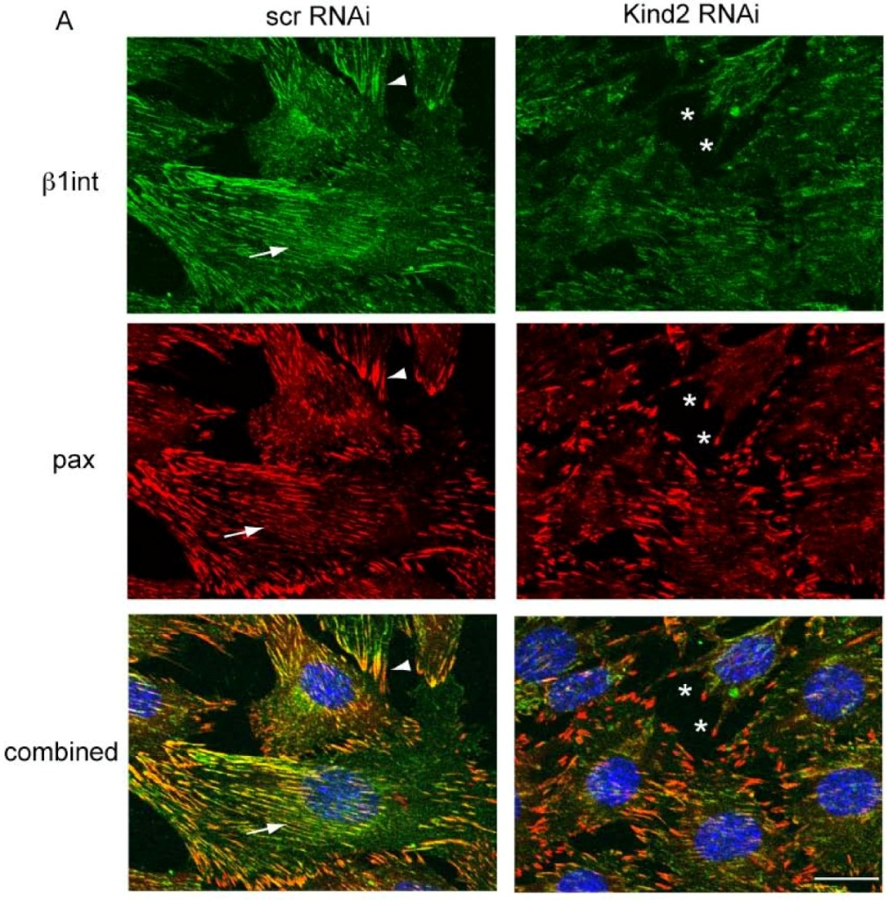
Figures
Clear figure legend
Kindlin-2 knockdown and focal adhesion localization. Confocal immunofluorescent microscopy with anti-β1 integrin and anti-paxillin on C2C12 cells transfected with RNAi and then changed to differentiation media for 2 days. Control cells show linear staining consistent with localization to costameres (arrows), as well as punctate focal contact staining (arrowheads). Focal contact proteins in the kindlin-2 RNAi cells fail to form linear structures and instead are concentrated in unusual appearing puncta (*). (Scale bar = 20 μM).
Title of the experiment
Brief methodology
Key findings
Clear indicators
Dowling et al. (2008) BMC Cell Biol 9:36.

Slide 29
Discussion
Summary of findings
Relevance of findings
Resumen de los resultados, interpretación de los resultados en el contexto de lo publicado previamente, relevancia de los resultados
Implications for
the field

Slide 30
Discussion – flow of information
Summary
GPER is an E₂ binding, G-protein coupled membrane receptor that was reported to be overexpressed in breast endometrial, ovarian and thyroid cancers. The results presented here extend these observations to show that different types of lung cancers including adenocarcinomas, squamous cell carcinoma and large cell carcinomas express higher GPER than normal lung tissue. Here, we demonstrate for the first time that GPER is overexpressed in lung tumors and lung adenocarcinoma cell lines relative to normal lung and immortalized normal lung cell lines, although the expression of GPER transcript in HPL1D cells is higher than HBECs.
GPER has been postulated to be involved in E₂-activation of EGFR. Filardo’s group showed a link between GPER expression and tumor progression and increased tumor size in breast cancer patients. Recently, GPER overexpression was reported to be independent of ERα expression in breast cancer patient samples, indicating the importance of GPER in ERα negative tumors. GPER and EGFR expression were correlated in endometrial adenocarcinoma. Further, overexpression of GPER in advanced stage endometrial adenocarcinoma correlated with poor survival. Other studies also suggest increased GPER in breast, ovarian and endometrial cancers correlates with disease severity and reduced survival. These results are in agreement with studies demonstrating association of GPER overexpression in other cancers, although the scoring patterns and correlation of expression levels to disease state may vary among these studies.
A limitation of our study is that the average GPER staining scores among different lung cancer grades (I (10 cases), II (30 cases), III (16 cases)) were not significantly different. One other limitation of the current study is that we cannot conclude at this time whether GPER overexpression is cause or consequence of cancer. It is also possible that overexpression of GPER in lung cancers may reflect a defense mechanism to counteract excessive proliferation. Indeed, a recent report by Krakstad et al. showed that loss of GPER in ERα-positive endometrial cancers is associated with poor prognosis. Another study showed that the GPER agonist G-1 inhibited E₂-induced uterine epithelial cell proliferation in mice by repressing MAPK activation, indicating that GPER effects are tissue specific. Because our studies were performed on commercial TMAs, the results cannot be extrapolated to correlate GPER expression levels to disease outcomes. Clearly, this is a next logical step in light of the novel findings.
We observed no differences in GPER expression between adenocarcinoma cell lines or tumors from male and female patients, similar to the previous findings of no difference in ERα or ERβ expression in NSCLC cells and tumors based on gender. In Western blots, rather than rely on one GPER antibody in our study, we used 3 different commercial antibodies to determine the correlation between mRNA and protein levels. It is indeed evident from our Western blot data that GPER appears to have different MW forms, likely due to glycosylation, dimerization, and interaction with other membrane proteins, and levels in the lung adenocarcinoma cell lines. More trivial explanations for the different staining patterns of GPER in Western blots may be due to differential purity/affinity of the three GPER antibodies as well as their capacity to bind to secondary antibodies. It will be important to determine the nature of these forms by proteomic analysis and gene sequencing to evaluate their biological significance.
Mechanism-based studies showed that GPER transactivates EGFR in breast cancer cells as well as in thyroid, endometrial and ovarian cancer cell lines. Inhibitors of EGFR tyrosine kinase (gefitinib) and ER (fulvestrant, ICI 182,780) were reported to synergize their anti-proliferative effects in NSCLC . Given the importance of EGFR signaling as a therapeutic target in lung cancer, further examination of the effect of EGF, heregulin, and amphiregulin on GPER expression and function in lung cancer may provide new insights into resistance to EGFR inhibitors and or how estrogens stimulate lung cancer.
In conclusion, the data presented in this manuscript demonstrate that GPER expression is higher in lung tumors compared to normal lung tissue. While it is not yet clear that elevated GPER expression is a cause of or consequence from lung cancer progression. Functional analysis of the effect of GPER expression will facilitate further delineation of the role of GPER in lung cancer.
Key findings
Relevance
Previous studies
Unexpected results
Si usted no presenta las limitaciones de sus experimentos, lo harán los revisores
Limitations
Conclusions
Major conclusion
Cuando sugiera trabajos en el futuro, indique por qué son necesarios
Implications
Rao Jala et al. BMC Cancer 2012;12:624.

Slide 31
Linking your ideas
Su manuscrito debe contar una historia sobre sus resultados
General background
Current state of the field
Introduction
Problems in the field
Objectives
Methods
Methodology
Results
Results and figures
Summary of findings
Discussion
Relevance of findings
Implications for the field
Logically link your ideas throughout your manuscript
Notes:
Ask how some people read articles…

Slide 32
Linking your ideas
Introduction
New ways to treat or prevent lung cancer
are therefore needed.
Problem
This study explored the hypothesis that inhibition of TNKS…would inhibit lung cancer growth…
Objectives
Discussion
Pharmacological or genetic inhibition of TNKS1 and TNKS2…reduces lung cancer proliferation...
Conclusion
Busch et al. BMC Cancer. 2012;13:211.
Notes:
Ask how some people read articles…

